Slide 1
CSC 4760 / 6760 Big Data Programming
Spring 2020
Assignment 6 K-means Clustering

Slide 2
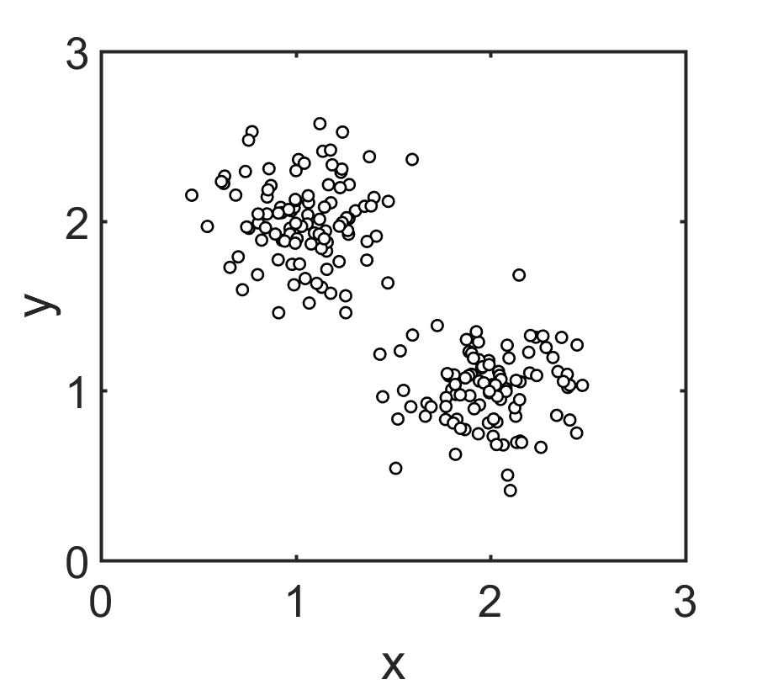
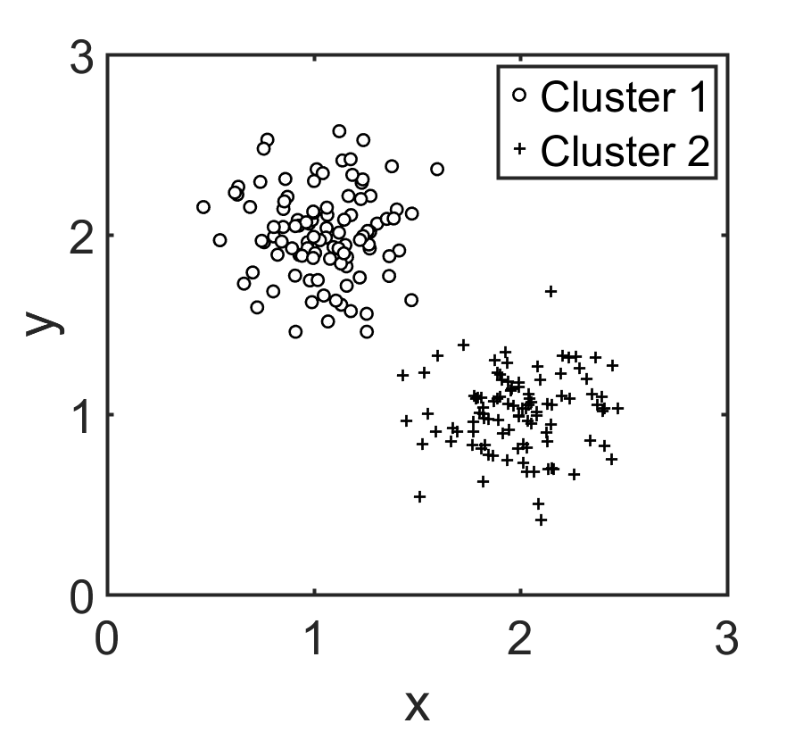
Cluster Analysis
Objects within the same cluster shall be as similar as possible
Objects of different clusters shall be as dissimilar as possible

Slide 3
What is Cluster Analysis?
Cluster: a set of data objects
Similar to one another within the same cluster
Cohesive
Dissimilar to the data objects in other clusters
Distinctive
Cluster analysis
Measure the similarities between data objects
Group similar data objects into clusters
Unsupervised learning: no predefined classes
Applications:
As a stand-alone tool to get insight into data distribution
As a preprocessing step for other algorithms

Slide 4
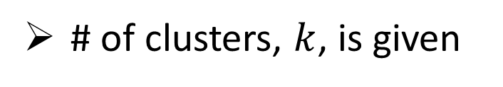
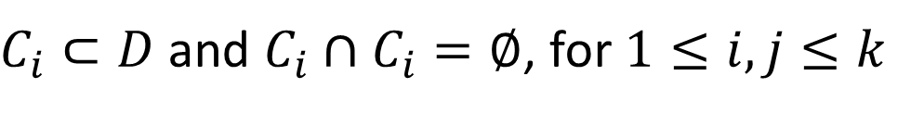
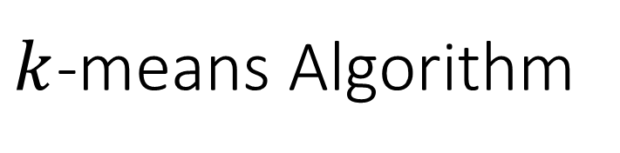
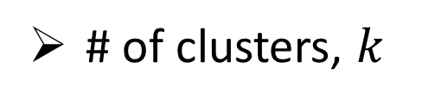
$k$-means Algorithm
Assumptions:
# of clusters, $k$, is given
Mutual Exclusive: Each data point only belongs to one cluster
Inputs:
Dataset $D$ contains $n$ data points in Euclidean space
# of clusters, $k$
Goal:
Partitioning points into $k$ clusters, $\left\{C_{1},C_{2},⋯,C_{k}\right\}$
$C_{i}⊂D$ and $C_{i}∩C_{i}=∅$, for $1≤i,j≤k$

Slide 5

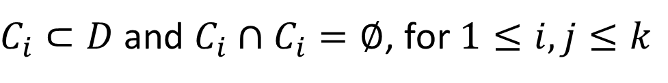
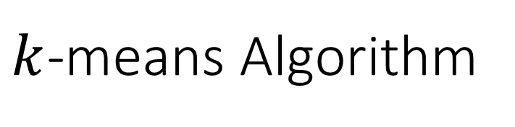
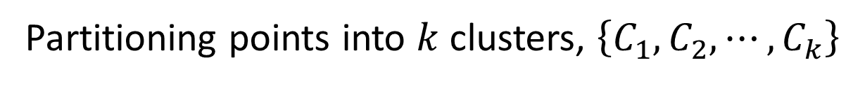
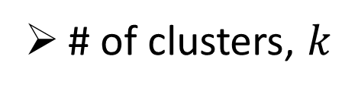

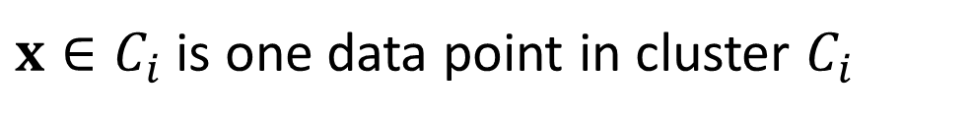
$k$-means Algorithm
Inputs:
Dataset $D$: $n$ data points
# of clusters, $k$
Goal:
Partitioning points into $k$ clusters, $\left\{C_{1},C_{2},⋯,C_{k}\right\}$
$C_{i}⊂D$ and $C_{i}∩C_{i}=∅$, for $1≤i,j≤k$
Minimizing the sum of squared error:
Minimize
$\sum_{i=1}^{k}{\sum_{x ∈ C_{i}}{dist{\left(x,μ_{i}\right)}^{2}}}$
$x∈C_{i}$ is one data point in cluster $C_{i}$
$μ_{i}=\frac{1}{\left|C_{i}\right|}\sum_{x ∈ C_{i}}{x}$: the centroid (center point) of a cluster, $C_{i}$
$dist\left(x,μ_{i}\right)={\left\|x−μ_{i}\right\|}_{2}^{2}$: Euclidean distance between two data points $x$ and $μ_{i}$

Slide 6

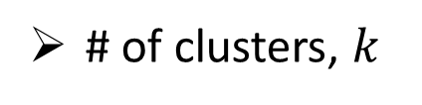



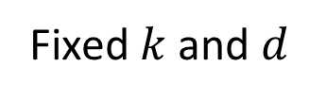
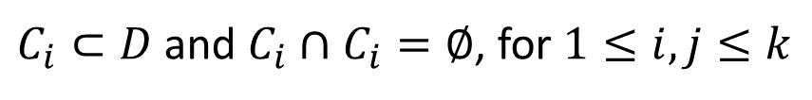

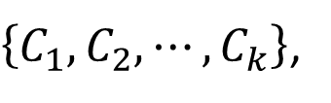
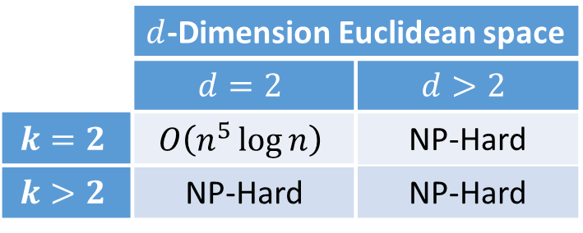
Time Complexity
Inputs:
Dataset $D$: $n$ data points
# of clusters, $k$
Goal:
$\left\{C_{1},C_{2},⋯,C_{k}\right\}$,
$C_{i}⊂D$ and $C_{i}∩C_{i}=∅$, for $1≤i,j≤k$
Minimize
$\sum_{i=1}^{k}{\sum_{x ∈ C_{i}}{dist{\left(x,μ_{i}\right)}^{2}}}$
Naïve : Enumerate all $k^{n}$ partitions
Time complexity of exact solutions:
 | $d$-Dimension Euclidean space
 | $$d=2$$ | $$d>2$$
$$k=2$$ | $$O\left(n^{5}\log{n}\right)$$ | NP-Hard
$$k>2$$ | NP-Hard | NP-Hard
$$3^{15}=1.4×{10}^{7}$$
Fixed $k$ and $d$
$$O\left(n^{kd+1}\log{n}\right)$$

Slide 7
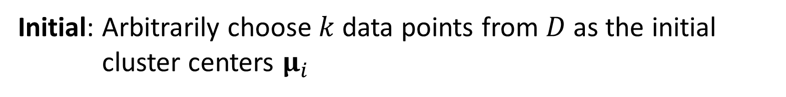
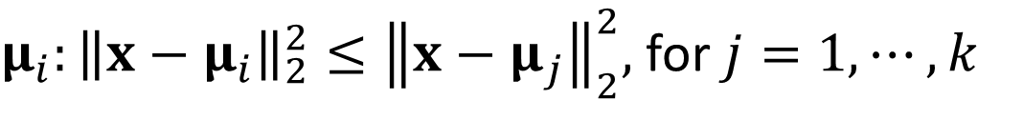
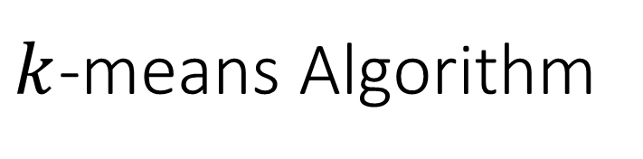
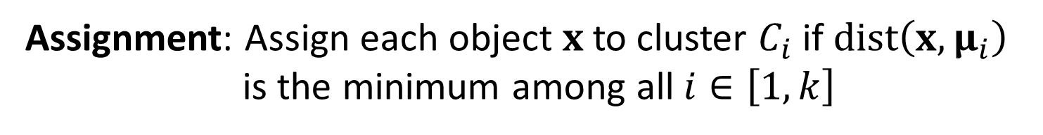
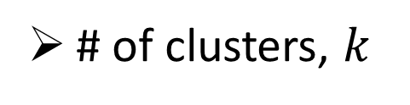

$k$-means Algorithm
Inputs:
Dataset $D$: $n$ data points
# of clusters, $k$
Initial: Arbitrarily choose $k$ data points from $D$ as the initial cluster centers $μ_{i}$
Repeat:
Assignment: Assign each object $x$to cluster $C_{i}$ if $dist\left(x,μ_{i}\right)$ is the minimum among all $i∈\left[1,k\right]$
$μ_{i}:{\left\|x−μ_{i}\right\|}_{2}^{2}≤{\left\|x−μ_{j}\right\|}_{2}^{2},$ for $j=1,⋯,k$
Update: Update the cluster means $μ_{i}=\frac{1}{\left|C_{i}\right|}\sum_{x ∈ C_{i}}{x}$
Until no change

Slide 8
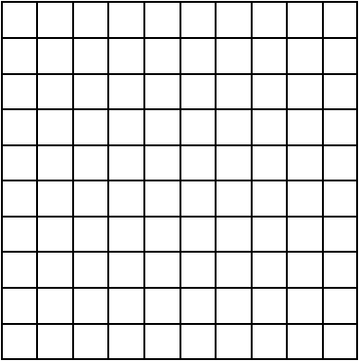



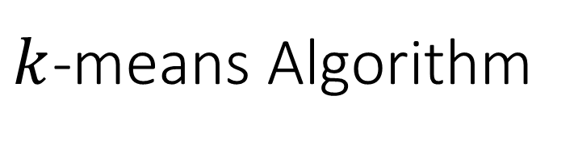




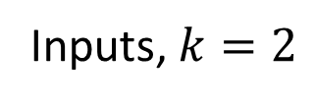

$k$-means Algorithm
$$10$$
$$10$$
$$0$$
$$0$$
$$0$$
$$10$$
$$0$$
$$10$$
Inputs, $k=2$
Initialize

Slide 9



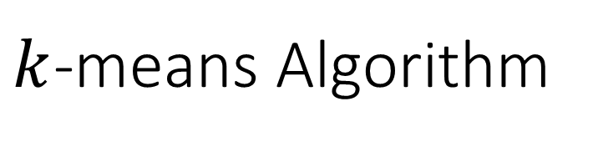



$k$-means Algorithm
$$\left(2.8, 7.3\right)$$
$$10$$
$$10$$
$$0$$
$$0$$
$$0$$
$$10$$
$$0$$
$$\left(6.1, 3.1\right)$$
$$10$$
Assign Each Data Point
Update Cluster Centers

Slide 10


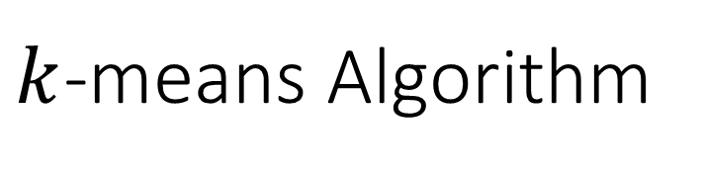


$k$-means Algorithm
$$\left(2.8, 7.3\right)$$
$$\left(2.75, 6.875\right)$$
$$10$$
$$10$$
$$0$$
$$0$$
$$0$$
$$\left(6.1, 3.1\right)$$
$$10$$
$$0$$
$$\left(7, 2.5\right)$$
$$10$$
Assign Each Data Point
Update Cluster Centers

Slide 11

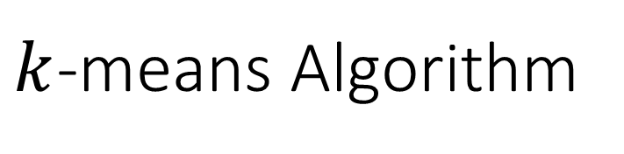

$k$-means Algorithm
$$\left(2.75, 6.875\right)$$
$$10$$
No Change
Terminate the Algorithm
$$0$$
$$0$$
$$\left(7, 2.5\right)$$
$$10$$
Assign Each Data Point

Slide 12

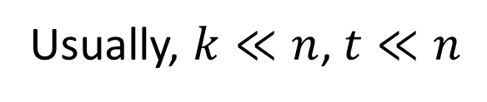
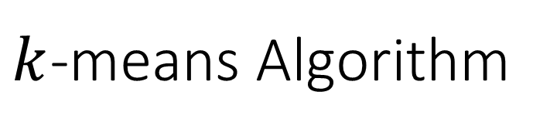
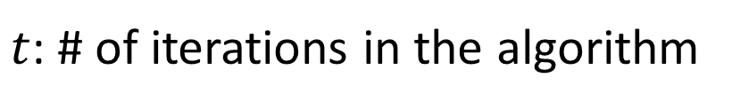
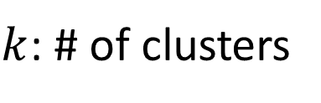
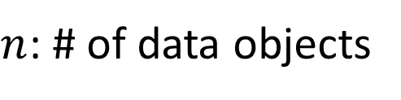
$k$-means Algorithm
$n$: # of data objects
Time Complexity:
$$O(tkn)$$
$k$: # of clusters
$t$: # of iterations in the algorithm
Usually, $k≪n$, $t≪n$
Comments:
1. Often terminates at a local optimum
Depend on the initial random selection of cluster centers
2. For global optimum, use deterministic annealing and genetic algorithms

